Slide 1
Introduction to Networks and Wireshark
Networking 101 Day 1

Slide 2
Today’s Objectives
By the end of class, you will be able to:
Define basic networking terms and explain how data is transmitted over the network.
Describe how protocols structure and define the data transmitted over the network.
Outline the OSI Model and explain each layer.
Compare and contrast the OSI and TCP/UDP model.
Capture communication over the network using Wireshark.
Explain the basics of a packet in Wireshark.

Slide 3
Introduction to Networking

Slide 4
Where Are we?
Networking is critical for nearly all these roles. A solid understanding of networking is fundamental to almost all cybersecurity.
Security Analyst | Security Operations Center Analyst (SOC) | Security Engineer | Systems Engineer
Cyber Threat Analyst | Cyber Defense Analyst | Incident Response Analyst | Intelligence Analyst
Information Assurance Technician | Risk Analyst | Forensics Investigator | Systems Administrator
Network Engineer | It Auditor | Application Security Engineer | Penetration Tester
Information Analyst | Systems Security Analyst | IT Specialist | Web Engineer - Application Security

Slide 5
The Journey of a File

Slide 6

A network is a group of computer systems and computing devices that are linked together through communication channels to facilitate communication and resource sharing among a wide range of users.

Slide 7

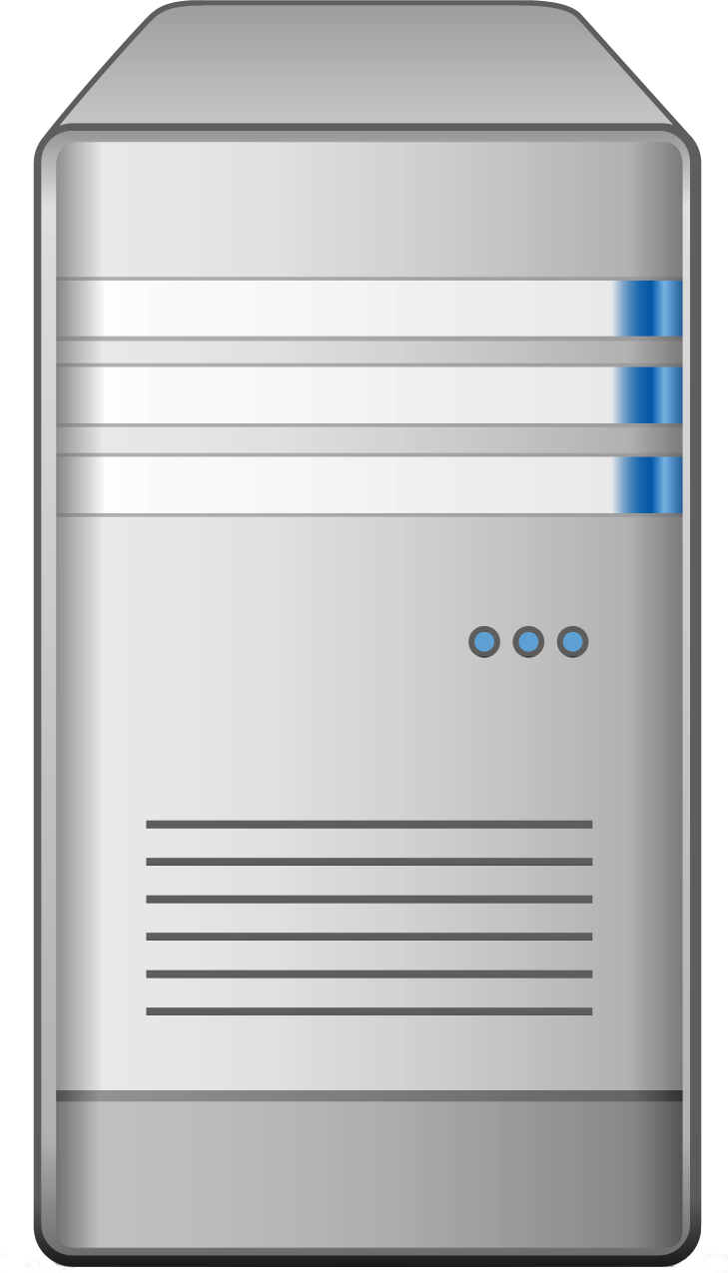
Network Communication: The Client Server Model
Network communication occurs largely between clients and servers.
Notes:
Clients can be anything such as a computer, phone, or camera. They may request data such as files, maps, web pages, and images.

Slide 8


Network Communication: The Client Server Model
Multiple clients often communicate with a single server.
(smart bulb)

Slide 9

Client / Server Model
A lot of this seems like magic!
The Client sends a request for info to the server.
Client: I’d like file X please
x
2. The server responds with data.
Server: Here’s file X you asked for

Slide 10
Client / Server Model
But there’s a lot to learn about this “simple” process:
How does the client find the server and vice versa?
How is this request made?
How is it sent?
Client: I’d like file X please
x
Server: Here’s file X you asked for
How is this file found?
How is it sent?

Slide 11
Activity: Explaining Communication
In this activity, you will pair up and think about how some common tasks might fit into the client / server framework.
Instructions sent via Slack
10 Minutes

Slide 12
Activity: Explaining Communication
10 Minutes
Instructions:
With a partner, investigate and explain how each of the following might work in communicating over the network:
File Transfer
Email
Web Page
For each scenario, think about and try to explain each of the following:
Who is the client? The server?
What does the request look like? The response?
What work does the client do? The server?
What is being communicated?
Use Google to help you in your investigation!

Slide 13
Explaining Communication Review
File Transfer:
The Client sends a request for info to the server.
Client: I’d like file X please
x
2. The server responds with data.
Server: Here’s file X you asked for

Slide 14

Explaining Communication Review
Web Pages:
User selects a link in the browser.
Browser formats the request and sends it to the server
Server finds the requested web pages.
Click me
-.--..-.-.-.-.-.-.-.-..
..-..-.-
##AGH58e!@5837FFFfH^#$__R)@J34G(
-.--..-.-.-.-.-.-.-.-..
..-..-.-
-.--..-.-.-.-.-.-.-.-..
..-..-.-
##AGH58e!@5837FFFfH^#$__R)@J34G(
-.--..-.-.-.-.-.-.-.-..
..-..-.-
Website
-.--..-.-.-.-.-.- HTML..
..-..-.-
-.--..-.-.-.-.-.-.-.-..
..-..-.-
##AGH58e!@5837FFFfH^#$__R)@J34G(
-.--..-.-.-.-.-.-.-.-..
..-..-.-
-.--..-.-.-.-.-.-.-.-..
..-..-.-
##AGH58e!@5837FFFfH^#$__R)@J34G(
-.--..-.-.-.-.-.-.-.-..
..-..-.-
Browser receives HTML and renders it into a user display
Server formats the response and sends it to the client (browser).

Slide 15
Explaining Communication Review
Email:
Client: Sender Nick
Mail Server
Client: Receiver Peleke
To: peleke@yo.yo
From: nick@yo.yo
Yo Yo Yo! How it go?
To: peleke@yo.yo
From: nick@yo.yo
Yo Yo Yo! How it go?
For some communication, there may be more than one server behind the scenes doing work.

Slide 16

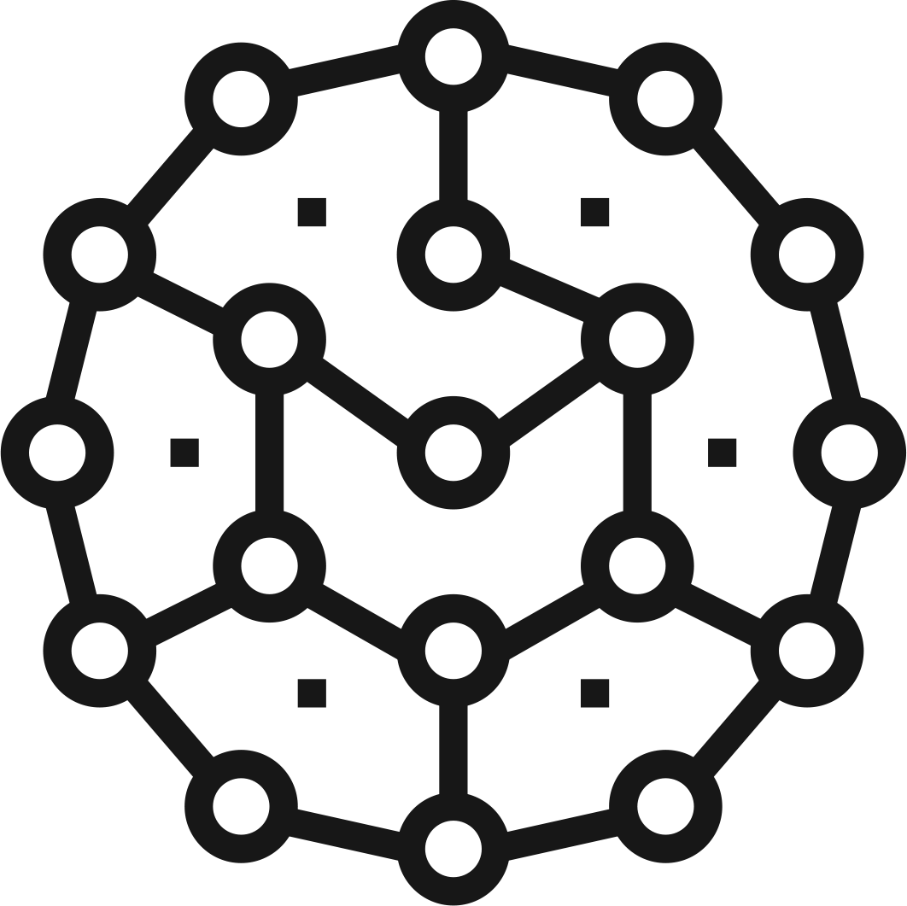

Explaining Communication Review
Networking Definitions
Network: A system of computers and other devices (printers, smart objects) that are connected to each other.
Network Communication: Transmission of data between two or more computers over a network.
Client / Server: Multiple end devices (clients) communicating over a network with a single central computer (server)
Request / Response: A basic method of computer communication, in which one computer sends a request for data to a second computer that responds to that request.

Slide 17
Introduction to Protocols

Slide 18
Request/Response and Binary
All digital data is transmitted via binary.
Here’s file X you asked for
I’d like file X please
Here’s file X you asked for
Here’s file X you asked for
x
x
111000100101010100010011100
000110010101101011010111001
000110010101101011010111001
111000100101010100010011100

Slide 19

A Protocol is a set of standardized rules that specify how interactions between communicating entities should work.
How networks communicate and provide structure to the binary data that is transmitted.

Slide 20
Protocol Example: Authentication
PAP: Password Authentication Protocol
Username: Alice
Password: awesomeAlice1
Accept / Reject
Alice’s Personal Computer
Server
PAP Two-Way Handshake

Slide 21
Protocol Example: Authentication
Client request contains bits in a specific order and length, per the standard and rules of the protocol.
Username: Alice
Password: awesomeAlice1
Accept / Reject
Alice’s Personal Computer
Server
1 Byte | 1 | 2 Bytes | 1 Byte | Variable | 1 Byte | Variable
Code: 1 | ID | Length | User name length | User name | Password Length | Password
Notes:
HTTP:80
HTTPS:443
FTP:21
SSH:22

Slide 22
Protocol Example: Authentication
The server receiving the request will know where to look in the bitstream for content: the username and password.
Username: Alice
Password: awesomeAlice1
Accept / Reject
Alice’s Personal Computer
Server
1 Byte | 1 | 2 Bytes | 1 Byte | Variable | 1 Byte | Variable
Code: 1 | ID | Length | User name length | User name | Password Length | Password

Slide 23
Ports
Ports are access points used by data that is packaged and interpreted by protocols.
0 - 1023: System Ports
1024 - 49151: Registered Ports
49152 - 65536: Dynamic / Private Ports

Slide 24

Source / Destination Ports
Source Port: Randomly generated from unregistered port range
Destination Port: Dependent on the protocol
151.20.0.145
Port 80
“I’d like cat.jpg please”
188.4.4.72
Port 50158
OK. Here’s the file you asked for:
Notes:
Cat Shutterstock ID: 1041783286

Slide 25
Activity: Ports and Protocols
In this activity, you will identify the correct port number and functions for a given list of protocols.
Instruction sent via Slack.
10 Minutes

Slide 26
Ports and Protocols

Slide 27
Today’s Objectives: Checkpoint
By the end of class, you will be able to:
Define basic networking terms and explain how data is transmitted over the network.
Describe how protocols structure and define the data transmitted over the network.
Define the OSI Model and explain each layer.
Compare and contrast the OSI and TCP/UDP model.
Capture communication over the network using Wireshark.
Explain the basics of a packet in Wireshark.

Slide 28
The OSI Model

Slide 29
The Open Systems Interconnection (OSI) Model
The OSI Model provides a framework to better categorize and conceptualize the overwhelming volume of ports and protocols.
Layer 7: Application
The OSI Model depicts the travel of communication through 7 layers, slowly growing the data frame to incorporate aspects like protocol information, security measures, and other pertinent information.
Layer 6: Presentation
Layer 5: Session
Layer 4: Transport
Layer 3: Network
Layer 2: Data Link
Layer 1: Physical

Slide 30
OSI Model
Application 1
Application 2
Only the actual user data is presented to the application
Layer 7
Layer 7
UserData
UserData
Layer 6
Layer 6
Only the user data is presented to the application
Layer 5
Layer 5
UserData
Layer 4
Layer 4
UserData
Layer 3
Layer 3
Layer 2
Layer 2
UserData
Layer 1
Layer 1
UserData
Data Frame
Additional data in the Frame added for security, addressing, etc.
Data Frame
Eg. Profibus, DeviceNet, Ethernet
Network Cable

Slide 31
OSI Model
Data Transmitted
Data Received
Data
Layer 7: Application
Layer 7: Application
Data
Layer 6: Presentation
Layer 6: Presentation
Data
Layer 5: Session
Layer 5: Session
Segments
Layer 4: Transport
Layer 4: Transport
Packets
Layer 3: Network
Layer 3: Network
Layer 2: Data Link
Frames
Layer 2: Data Link
Layer 1: Physical
Bits
Layer 1: Physical
[Physical Link]

Slide 32
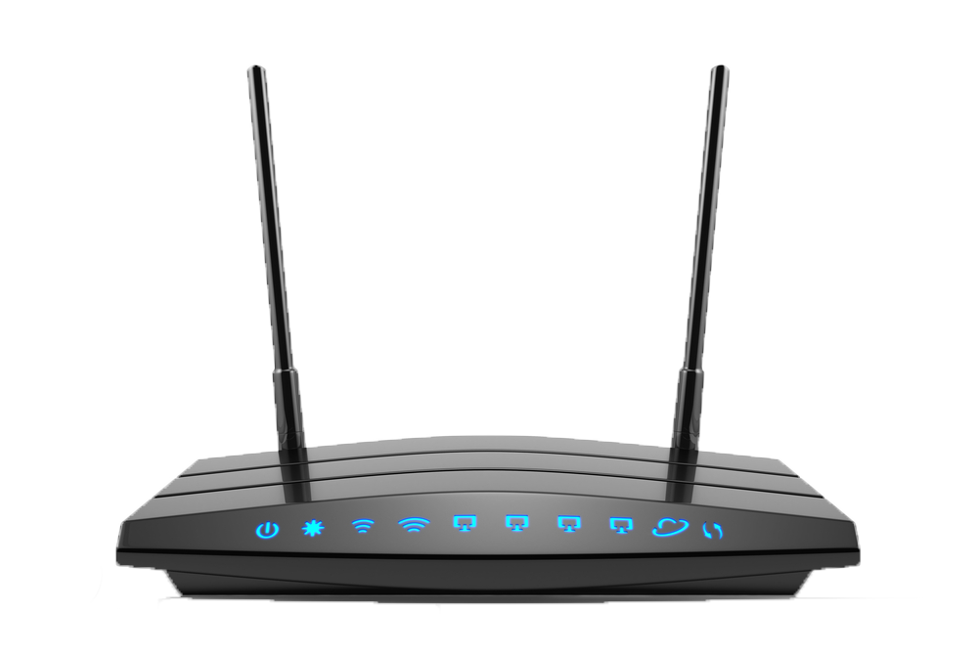

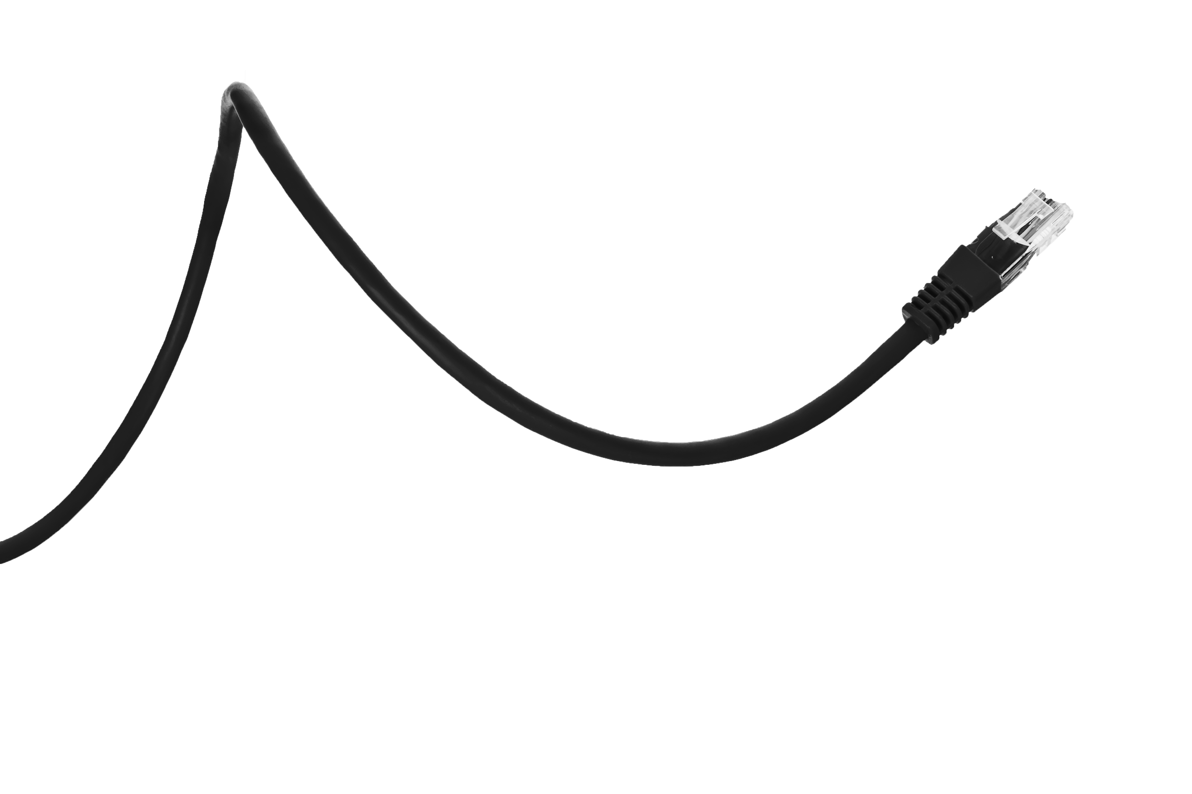
The OSI Model: Physical Layer
The Physical Layer is responsible for transmission of binary data via a physical medium. Handles how data is physically encoded and decoded.
Layer 7: Application
Layer 6: Presentation
Layer 5: Session
Layer 4: Transport
Layer 3: Network
Layer 2: Data Link
Layer 1: Physical

Slide 33
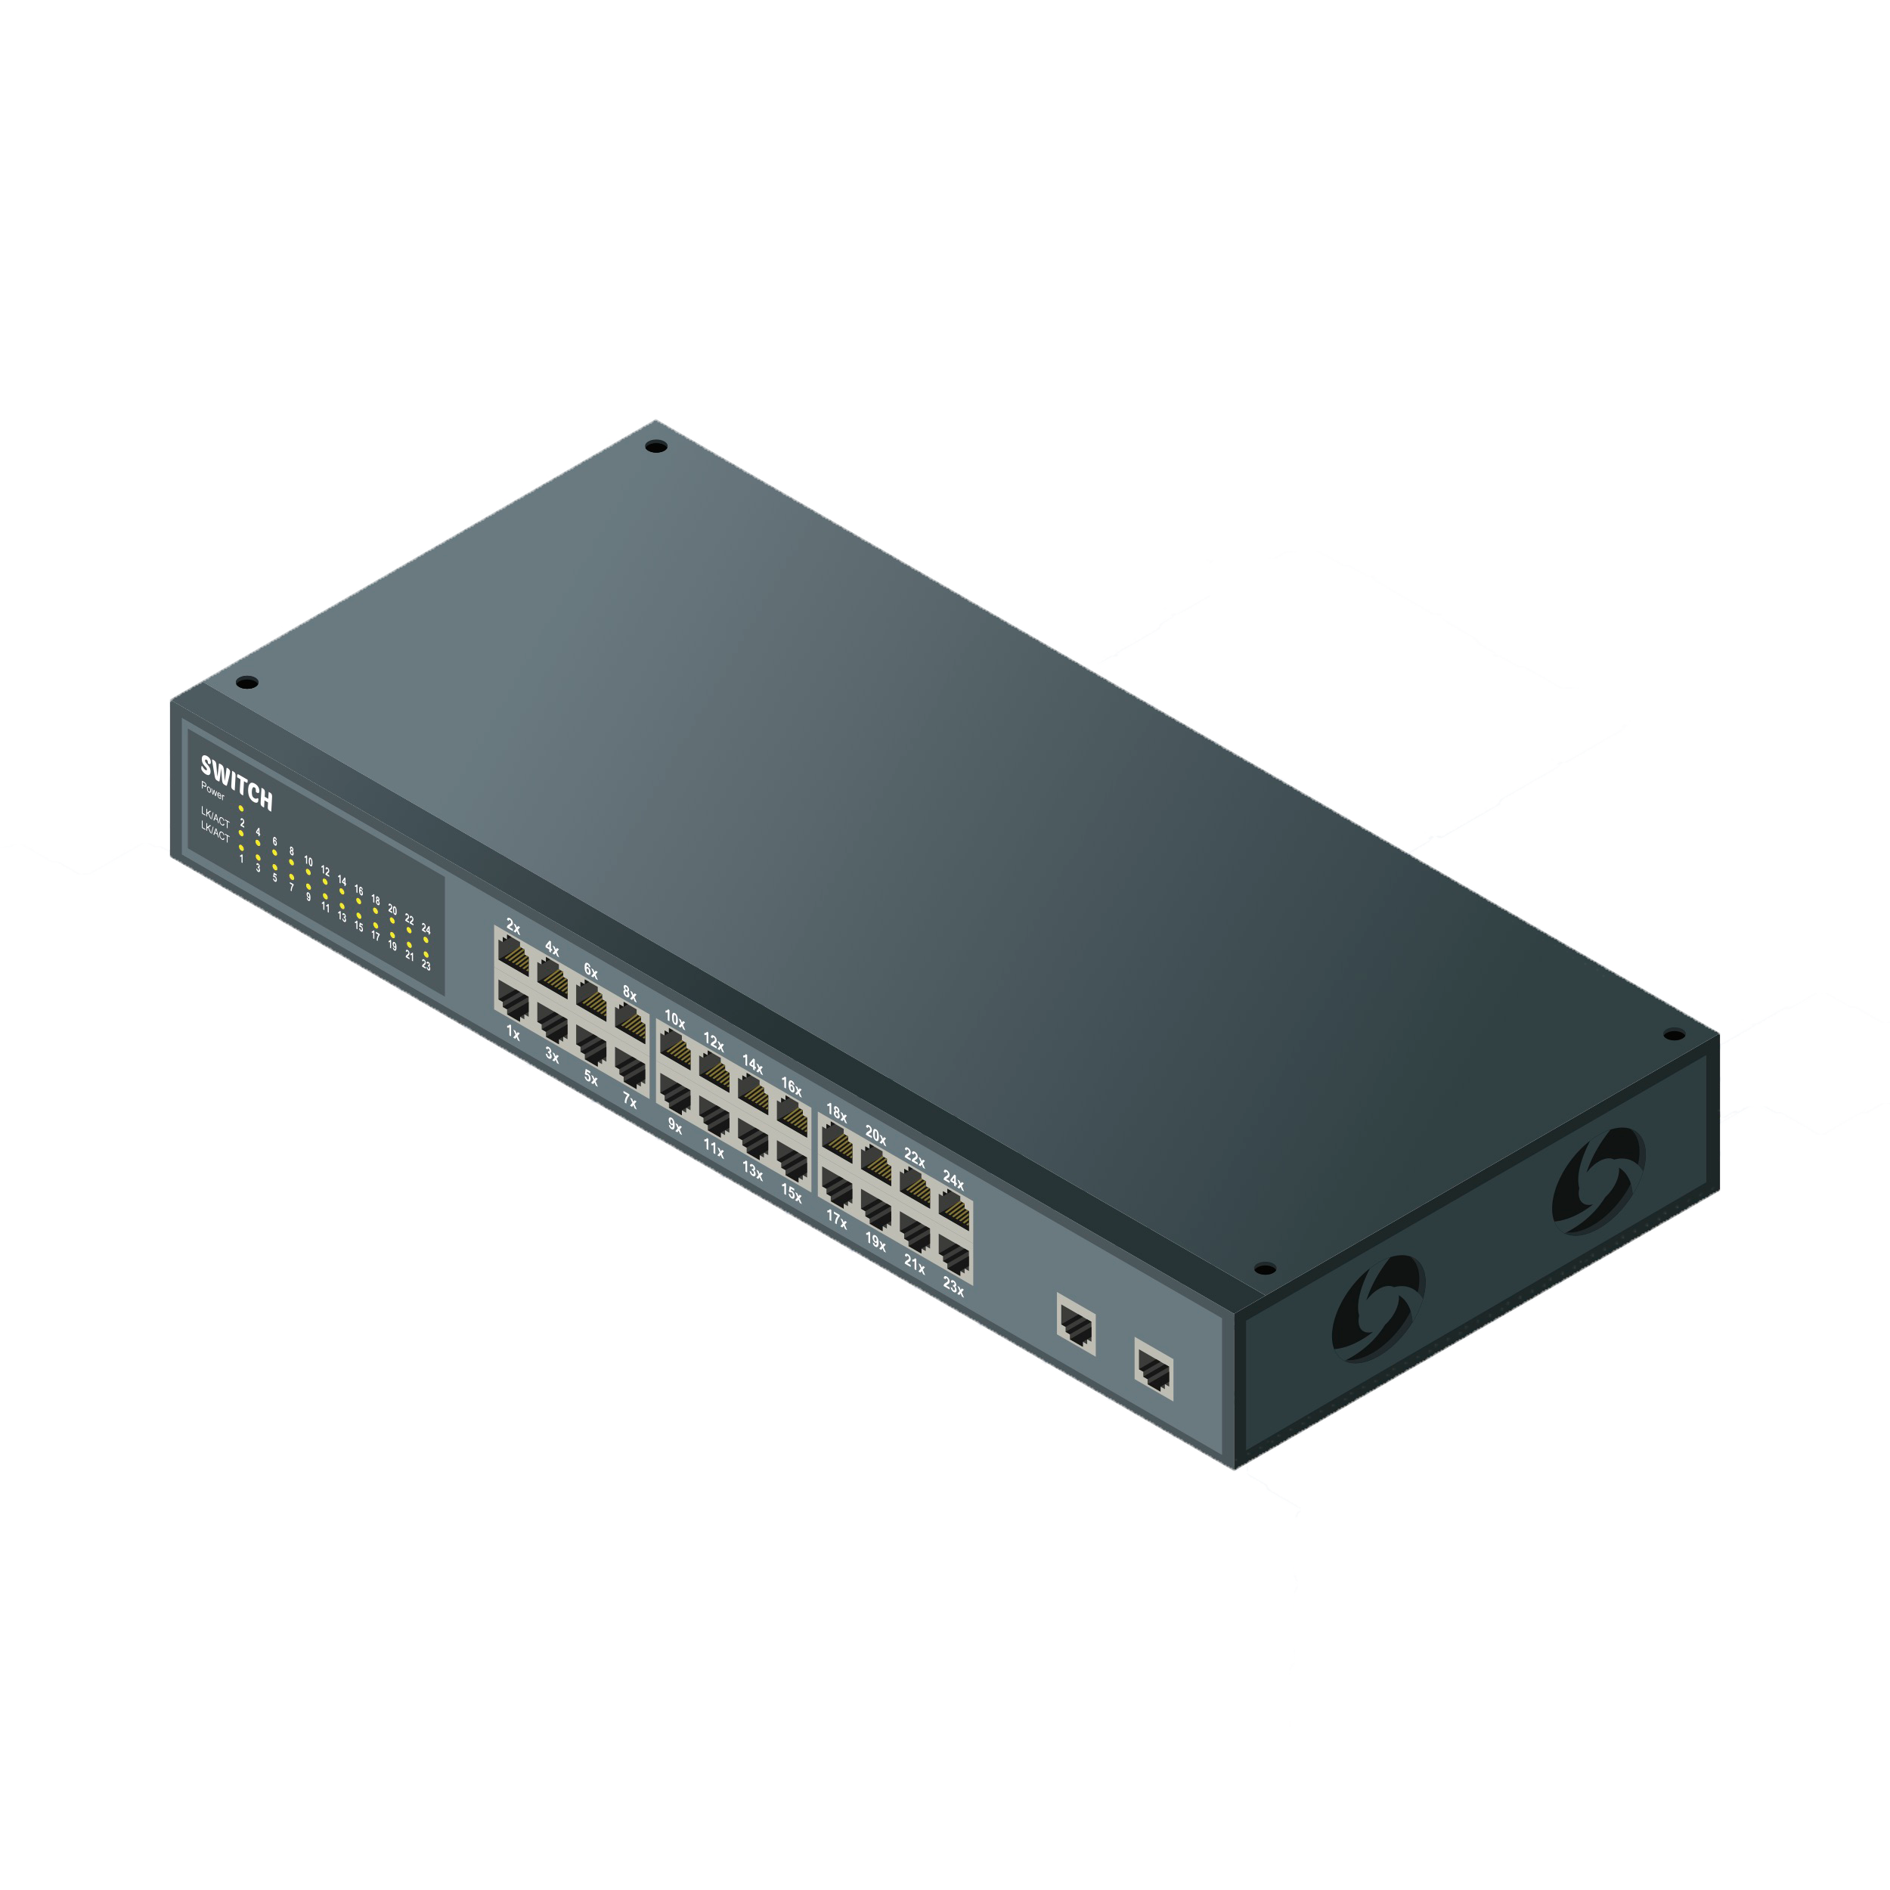


The OSI Model: Data Link
The Data Link layer establishes links between nodes and provides error-free handling of data transfer over the Physical layer.
Layer 7: Application
Layer 6: Presentation
Layer 5: Session
Layer 4: Transport
Layer 3: Network
Layer 2: Data Link
Layer 1: Physical

Slide 34
The OSI Model: Network Layer
The Network layer is responsible for routing data through physical networks, deciding which physical path the data will take, and ensure that it gets to the correct destination.
Layer 7: Application
Layer 6: Presentation
Layer 5: Session
Layer 4: Transport
Layer 3: Network
Layer 2: Data Link
Layer 1: Physical

Slide 35
The OSI Model: Transport
The Transport Layer is responsible for actually transmitting data across the network. (It puts data onto the network.)
Layer 7: Application
Layer 6: Presentation
Layer 5: Session
Layer 4: Transport
Layer 3: Network
Layer 2: Data Link
Layer 1: Physical

Slide 36
The OSI Model: Session Layer
The Session Layer manages connections between ports on computers and handles data flow.
Layer 7: Application
Layer 6: Presentation
Layer 5: Session
Layer 4: Transport
Layer 3: Network
Layer 2: Data Link
Layer 1: Physical

Slide 37


The OSI Model: Presentation Layer
The Presentation layer is the translator for the network. It formats the data to be presented to the Application layer. Handles data representation, de/encryption, character set translation and conversion.
Layer 7: Application
Layer 6: Presentation
Layer 5: Session
Layer 4: Transport
Layer 3: Network
Layer 2: Data Link
Layer 1: Physical

Slide 38



The OSI Model: Physical Layer
The Application Layer is responsible for representing data in a way the consuming application can understand.
Website
Layer 7: Application
Layer 6: Presentation
Layer 5: Session
Layer 4: Transport
Layer 3: Network
Layer 2: Data Link
Layer 1: Physical

Slide 39
Encapsulation / Decapsulation
Encapsulation converts data from an application on the source machine (like an image) into some that can be transmitted.
Application
User data converted for transmission
Presentation
Upper layer data
Session
TCP Header
Upper layer data
Transport
IP Header
TCP Header
Upper layer data
Network
MAC header
LLC header
IP Header
TCP Header
Upper layer data
FCS
Data Link
111010101111101101001100101010 → Sent to cable
Physical
Network Media

Slide 40
Encapsulation / Decapsulation
Decapsulation converts transmitted data into something that can be used on the destination's machine application.
Application
User data converted for transmission
Presentation
Upper layer data
Session
TCP Header
Upper layer data
Transport
IP Header
TCP Header
Upper layer data
Network
MAC header
LLC header
IP Header
TCP Header
Upper layer data
FCS
Data Link
111010101111101101001100101010 → Sent to cable
Physical
Network Media

Slide 41
OSI Model
Twitter OSI Model
Physical Layer: You just thought of a tweet that you need to share with the world, so you whip out your smartphone.
Data Link Layer: Your 280 character tweet is converted into binary 1s and 0s.
Network Layer: Your tweet is routed over various LAN and WANs. (Directing your tweet’s travel path).
Transport Layer: Packs up your 280 character tweet and sends it into the Twittershpere.
Session Layer: Provides order to a session. Like the traffic cop of data between transfers.
Presentation Layer: Translates binary 1s and 0s into a comprehensible format.
Application Layer: Your tweet is ready to be viewed by the world!

Slide 42
TCP / IP Model
The Transport Control Protocol / Internet PRotocol Model is another model, more in accordance with cybersecurity issues.
Layer 7: Application
Application Layer
Layer 6: Presentation
Layer 5: Session
Layer 4: Transport
Transport Layer
Layer 3: Network
Layer 2: Data Link
Internet Layer
Layer 1: Physical
Host-To-Network Layer

Slide 43
Activity: Fill in the Blanks
In this activity, you will practice familiarizing yourself with the OSI model.
Instructions sent via Slack.
10 Minutes

Slide 44
Fill in the Blanks

Slide 45
Take A Break

Slide 46
Intro to Wireshark

Slide 47
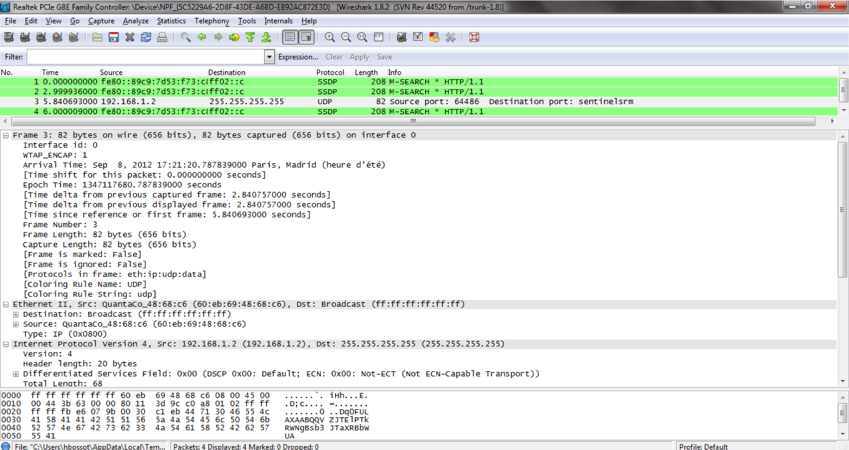
Packets and Wireshark
Communication between devices over a network is facilitated through the transfer of packets.
Wireshark is a tool that allows us to look at real communication across the network and monitor the network for activities of connected devices.

Slide 48
Packets
Communication between devices over a network is facilitated through the transfer of tiny packets.
Application
Data
Header | Sender’s IP Address, Receiver’s IP Address, Protocol... | 96 bits
Payload | Data | 660 bits
Trailer | Indicates end of packet, error correction | 32 bits
Presentation
Data
Session
Data
Transport
Segments
Network
Packets
Data Link
Frames
Physical
Bits
Each packet contains:
The address of its origin
The address of its destination
Some information that connects it to related packets being transmitted

Slide 49
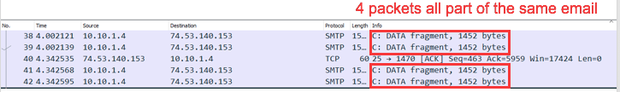
Packets
Communication between devices over a network is facilitated through the transfer of tiny packets.
Application
Data
Header | Sender’s IP Address, Receiver’s IP Address, Protocol... | 96 bits
Payload | Data | 660 bits
Trailer | Indicates end of packet, error correction | 32 bits
Presentation
Data
Session
Data
Transport
Segments
Network
Packets
Data Link
Frames
Physical
Bits

Slide 50
Activity: Install Wireshark
In this activity, you will install the wireshark application.
Instruction sent via Slack.
5 Minutes

Slide 51
Wireshark Walkthrough

Slide 52
Activity: Diving with the Wiresharks
In this activity, you will conduct a capture, investigate a packet capture files, and answer a series of questions about the traffic in a file.
Instruction sent via Slack.
10 Minutes

Slide 53
Inspecting a Packet

Slide 54
Activity: My First Sniff
In this activity, you complete your own practice capture.
Instruction sent via Slack.
10 Minutes

Slide 55
Today’s Objectives
By the end of class, you will be able to:
Define basic networking terms and explain how data is transmitted over the network.
Describe how protocols structure and define the data transmitted over the network.
Define the OSI Model and explain each layer.
Compare and contrast the OSI and TCP/UDP model.
Capture communication over the network using Wireshark.
Explain the basics of a packet in Wireshark.
Any Questions?

